Slide 1
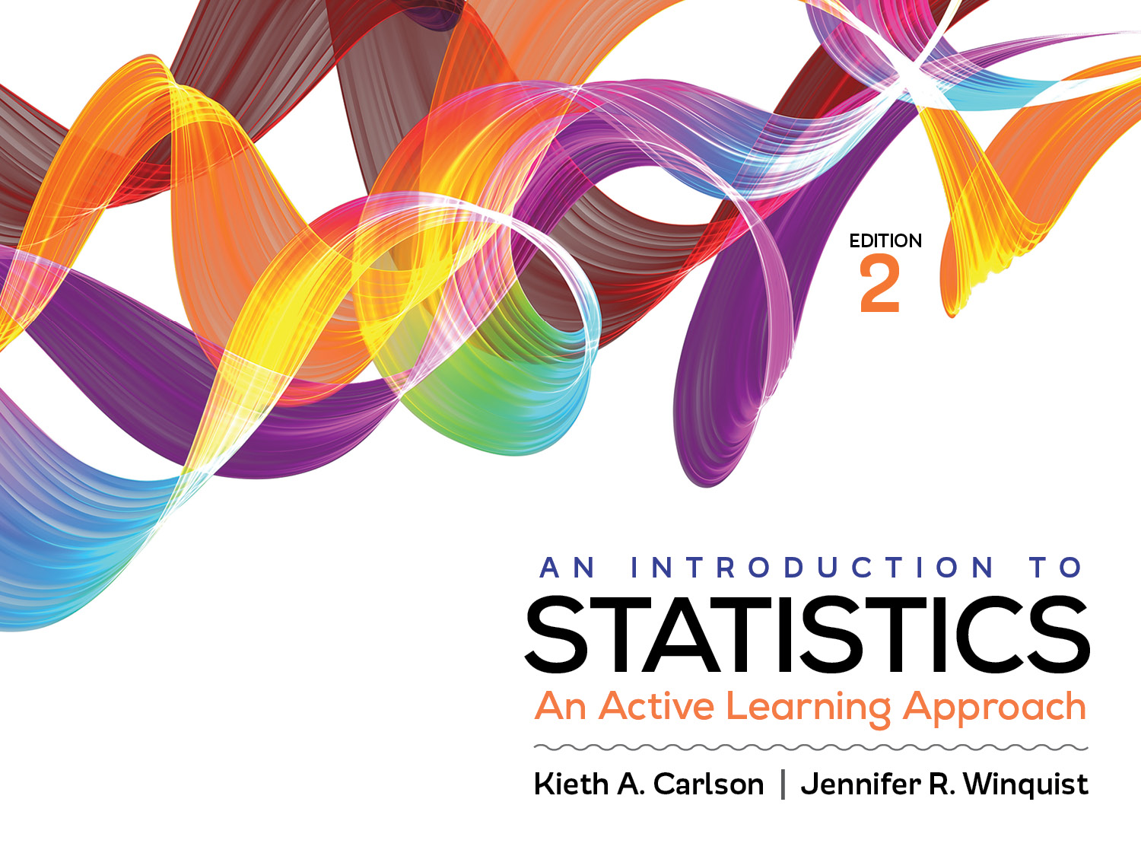
Activity 9.1
Hypothesis testing with the related samples t test (or dependent t test)

Slide 2
Activity 9.1 will require you to:
Determine if a 1- or 2-tailed significance test is appropriate
Conduct all 6 steps of a significance test using a related samples t
Produce SPSS output and interpret related sample t test results
Select the correct statistical test for different situations

Slide 3
Logic of the repeated samples t
If the treatment does NOT work at all, what do you expect the mean difference between M_{before} and M_{after} to be?
Sample of size N
Treatment
Measure
M_{after}
Population
Measure M_{before}
If the (M_{before} – M_{after} ) is NOT zero, is the difference likely created by sampling error or the treatment?
Notes:
If the treatment does not work at all the mean difference should be close to zero
If the mean difference is NOT zero, we compute the obtained repeated t, determine if probability of that t is low if the null is true.

Slide 4
Example
Does a drug increase scores on a memory test? To test this, a researcher
obtains a sample of 5 people
gives them all a memory test (pre-test; IV level 1 )
gives them all the drug (treatment)
gives them all a second memory test (post-test; IV level 2)
Both memory tests were administered to individual participants so they could not see what the other participants wrote.
Scores on the memory test were the number correct out of 10 (DV).
Past research suggests that the distribution of sample means differences is normally distributed.
Match each of the bullets to the relevant assumption.
Why is a 1-tailed hypothesis test appropriate?

Slide 5
Assumptions
Appropriate measurement of the IV and the DV
Two sample means collected from the same group and the DV are measured on an interval/ratio scale
Could also use “matched” groups
Independence
Procedural control
Normal distribution of sample mean differences
Know from past research that it is normally distributed, but should still be concerned due to the very small sample size. Would use a larger N in the real world.
No homogeneity of variance assumption

Slide 6
One-Tailed hypotheses
Research hypothesis (H₁)
µ_{drug} > 0
Note—this assumes that we compute difference scores (After-Before). If we computed them (Before-After) we would predict µ_{drug} < 0
The population’s mean memory score is higher after taking the drug than before taking the drug.
Null hypothesis (H₀)
µ_{drug} < 0
Note—same as above.
The population’s mean memory score is NOT higher after taking the drug than before taking the drug.

Slide 7
Critical values
df = N −1 where N is the number of paired scores
df = 5−1 = 4
Reject H₀ if t > 2.1318
Critical value

Slide 8
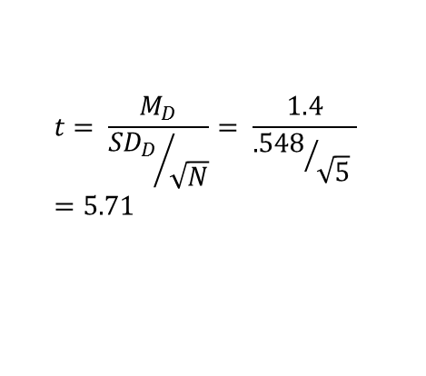

Computations
Be sure to subtract in the correct direction for the research hypothesis. In this case, After-Before because we predicted µ_{D} > 0
Before | After | Difference (D) 2 1 1 2 1 M_{D}=1.4 SD=.548 Use to compute the t and d
5 | 7
8 | 9
6 | 7
4 | 6
5 | 6
M_{B}=5.6 | M_{A}=7
SD_{B}=1.517 | SD_{A}=1.225
Use for interpretation in the write up
$$t= \frac{M_{D}}{{{SD}_{D}}/{\sqrt{N}}}= \frac{1.4}{{.548}/{\sqrt{5}} }=5.71$$
$$d= \frac{M_{D}}{{SD}_{D}}= \frac{1.4}{.548}=2.55$$
Notes:
A really common mistake student make is not using the difference scores when computing the repeated t. Stress that they need to use the difference scores NOT the raw scores.

Slide 9
Summary
Memory test scores after the treatment (M = 7.00, SD = 1.23) were significantly higher than scores before the treatment (M = 5.60, SD = 1.52), t (4) = 5.71, p < .05, d = 2.55. The large effect size suggests that the treatment is very effective, but this study should be replicated with a larger sample.

Slide 10
Repeated vs matched designs
Repeated
Measure the same people twice on a DV
Matched
Obtain two samples of people that are matched on some important variable (e.g., pre-drug memory score)
One person from each matched pair receives the treatment and the other does not; both are then measured on the DV
Repeated and matched t tests are computed in the same way

Slide 11
Choosing the correct statistic
Statistics for Comparing Means
Goal | Statistic
Compare a sample mean to a population mean or other value | Use a z for a sample mean if σ is known Use a single sample t if σ is unknown
Compare two sample means | Use a related samples t if the two samples are related (either matched or repeated measures)
Notes:
This is in Appendix J

Slide 12
Choosing the correct statistic
Repeated/Related samples t
The IV defines two matched samples and the DV is measured on an interval/ratio scale.
The IV defines one sample, the DV is measured on an interval/ratio scale, and the DV is measured twice, once before and once after treatment.
Single sample t
The IV defines one sample, the DV is measured on an interval/ratio scale and you do not know the population standard deviation.
z for a sample mean
The IV defines one sample, the DV is measured on an interval/ratio scale and you know the population standard deviation

Slide 13
Are you comparing sample means?
Yes
How many sample means?
No
Are the data frequency counts?
One
Two
Three or More
z for a sample mean
single sample t
Related samples t
Independent samples t
Two-way ANOVA
One-Way ANOVA
Is σ known?
Are the samples independent of each other?
Is there more than one IV/grouping variable?
Yes
No
Is there more than one IV/grouping variable?
Chi-Square Test of Independence
Chi-Square Goodness of Fit
Are both variables interval/ratio or is at least 1 ordinal?
Both interval/ratio
At least one is ordinal
Are you trying to predict one variable from another?
Spearman correlation
Regression
Pearson correlation
yes
no
yes
no
yes
no
yes
no
yes
no
Notes:
This is in Appendix J

